Slide 1
SESSION 1: Introduction to Peace and Conflict Theory
Dr. Roddy Brett
University of St. Andrews
October 2017

Slide 2
1. INTRODUCTIONS
2. EXPECTATIONS – WHAT THE COURSE ADDRESSES / IS ABOUT – this morning is taster – look at concepts that will be central to this course
3. YOUR PARTICIPATION (NO WRONG QUESTIONS)
4. BRIEF INTRO THEN TALK ABOUT CONTEXT / END OF AUTHORITARIANISM / EMERGENCE OF NEW AGENDA FOR PEACE

Slide 3
Paris:
Start of 20th century, approximately 90 percent of war victims were soldiers;
during the 1990s estimated 90 percent of those killed in armed conflicts were civilians.
Civil wars accounted for 94 percent of all armed conflicts fought in the 1990s
FROM THIS PERSPECTIVE
Attacks and atrocities against noncombatants became widely employed as deliberate strategies of warfare; including such tactics as systematic rape, mass executions, ethnic cleansing, and even genocide;
premodern forms of fighting that dispensed with customary constraints on the waging of war??? – NEW WARS THEORY…
Not sure this was as new as certain authors (Kaldor) would want us to believe (drugs, crime, polviol) – take a long historical perspective and we see that this is the case (English) – atrocities against civilians have always been a part of warfare
Nevertheless – CERTAIN CHANGES IN BOTH HOW WAR IS WAGED AND HOW CONFLICT IS RESOLVED OR TRANSFORMED DID ACCOMPANY THE END OF THE COLD WAR- civil war spirals

Slide 4
30 percent of all civil wars that started between 1988 and 1999 represented recurrences of prior civil wars that had ended in the previous ten years
IN THIS CONTEXT, LEVELS OF UN INTERVENTION IN INTRASTATE CONFLICT ESCALATED, AS DID THE NUMBER OF CONFLICTS RESOLVED THROUGH PEACE NEGOTIATIONS
BUT – 30-40% of negotiated settlements collapse within 10 YEARS
Suhrke and Samset – 25% chance of recurrence of civil war after negotiations – IN SHORT, NEGOTIATIONS ARE CLEARLY NOT AS EFFECTIVE AS WOULD LIKE LIKE TO BELIEVE
Collier et al - countries with a recent history of civil violence had an almost 50 percent chance of slipping back into violence, PARTICULARLY AFTER FIVE YEARS
So failed POST-CONFLICT RECONSTRUCTION IS A prevalent practical problem – that’s what this course is about (understand the theory and comparative cases)

Slide 5
BUT A CLEARLY URGENT QUESTIONS TO ASK IS HOW DO WE KNOW WHEN PEACE HAS FAILED AND WHEN IT HAS SUCCEEDED? WHAT ARE THE INDICATORS
IS NEGATIVE PEACE ALL WE EXPECT???
DO YOU HAVE TO HAVE A RECURRENCE OF ARMED CONFLICT OR CIVIL WAR FOR PEACE TO FAIL (ELSAL AND GUATEMALA)
SHOULD THOSE INVOLVED HAVE PUSHED FOR + PEACE?

Slide 6
CENTRAL peacebuilding challenge:
How, in the wake of bloody war, can WE foster a society that can resolve its conflicts without recourse to mass violence? QUESTION OF EXPECTATION? INTERNAL AND EXTERNAL ACTORS??
WHAT FACTORS GENERATE THE CONDITIONS TO PREVENT RECURRENCE TO CONFLICT?
CALL – NO SINGLE FACTOR OR VARIABLE WILL ACCOUNT FOR AND GUARANTEE SUCCESS IN BUILDING PEACE – BUT POLITICAL INCLUSION IS KEY, AS IS LEGITIMACY
State legitimacy – opinion that the political order is appropriate, moral, proper AND Regime legitimacy – is about the norms, rules, principles, values, procedures (can include process and performance legitimacy)
VOGEL - INCLUSION OF CIVIL SOCIETY
FEARON + LAITIN – POVERTY AND INSTABILITY
MACGINTY – PEACE DIVIDEND MUST BE WIDELY SHARED
BRETT – the above – but also ADDRESSING THE CAUSES OF CONFLICT
AND WHO SHOULD BE CHARGED WITH DEALING WITH THESE ISSUES (local / international)

Slide 7
UNDERSTANDING CONFLICT, WAR AND AUTHORITARIANISM

Slide 8
Interests
And how that violence and conflict are transformed and overcome…
Internal Armed Conflict
And
Authoritarianism
And Political Violence employed

Slide 9
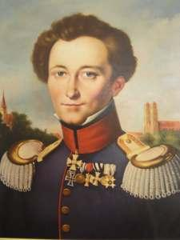
What makes a conflict into a war?
A State of armed conflict between different nations or states, or different groups within a nation or state– Oxford English Dictionary
1,000 battlefield fatalities within a 12-month period – COW [Correlates of War Project, University of Michigan, founded 1963]
War is an act of violence intended to compel our opponent to fulfil our will – Carl Von Clausewitz (1780-1831), On War (1832), page one

Slide 10
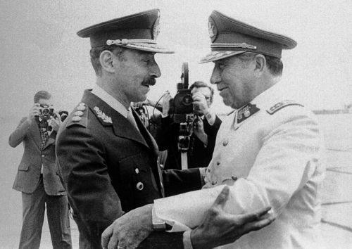
Dance of the dictators

Slide 11
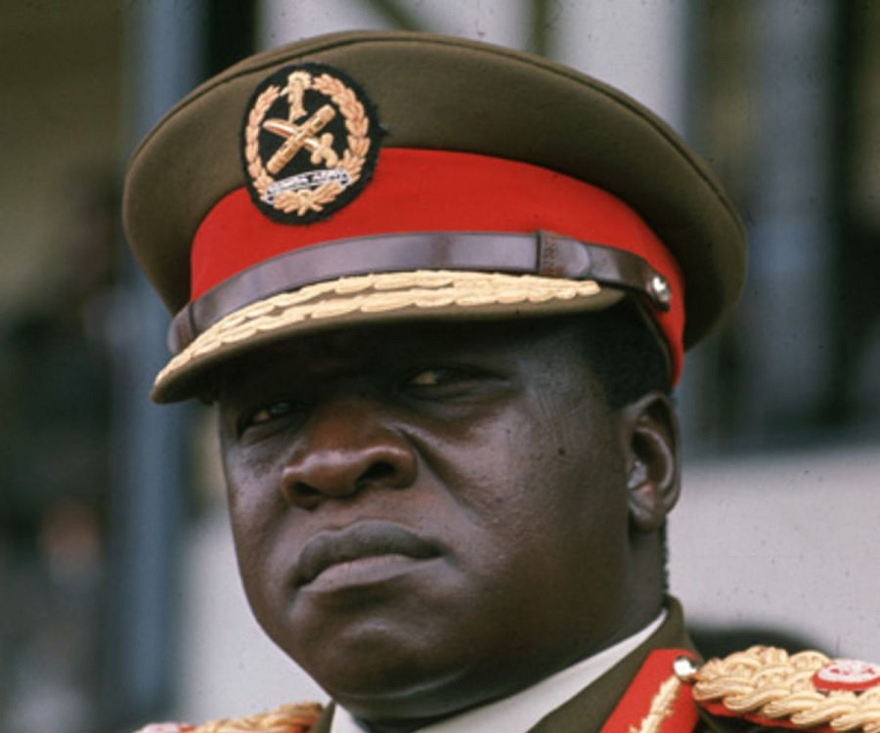
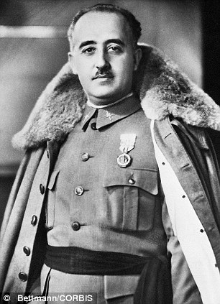
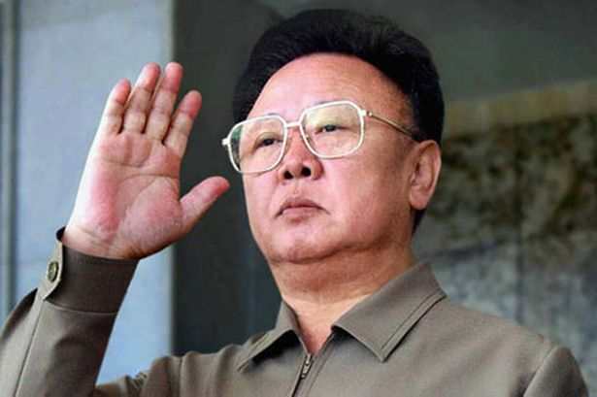
https://www.youtube.com/watch?v=rVcqSc12H4w

Slide 12
Generals Pinochet (CHILE: 1973-1990) and Videla (ARGENTINA: 1976-1981)
General Francisco Franco (SPAIN: 1939-1975)
General Idi Amin (UGANDA: 1971-1979)
Kim Jong-il (NORTH KOREA: 1994-2011)
Dictators; leaders of authoritarian regimes

Slide 13
W. H. Auden
Epitaph on a Tyrant
“Perfection, of a kind, was what he was after…When he laughed, respectable senators burst with laughter, And when he cried the little children died in the streets”

Slide 14
Characteristics of Authoritarianism / IAC:
POLITICAL EXCLUSION:
- the informal and unregulated exercise of political power (often by individual, junta, regime)
- self-appointed leadership (sometimes elected); extensive personal power
- no free choice among competitors
SOCIAL CLOSURE:
- arbitrary deprivation of civil liberties and exercise of law / judiciary
- little tolerance for meaningful opposition
- social control (closure of civil society)
REPRESSION:
- political stability maintained by control over and support of the armed forces; bureaucracy staffed by the regime; creation of networks of allegiance (through socialisation and indoctrination)
- use of violence (threat; attack; torture; disappearance; homicide; massacre) against ever increasing circle of regime enemies – ‘not just the bomber but the ideologue’ (Videla) (CaH; genocide)

Slide 15
Objectives?
Dynastic rule (Somoza, Nicaragua; Kim Jong-Il, NK)
Combat subversion and bring back order (Pinochet, Chile; Suharto, Indonesia; Rios Montt, Guatemala)
Economic modernisation (Pinochet, Chile; Videla, Argentina)
Nation-building / social engineering (Videla, Argentina)

Slide 16
Characteristics
Militarisation of state apparatus
Weakening of institutions (no rule of law)
Entrenched corruption (Suharto; Pinochet; Montt)
Consolidation of clientelist networks (military; party – national + local)
Closure of civil society spaces
Imposition of a culture of terror and fear

Slide 17
Juan Linz (1964)
Authoritarian regimes defined as political systems characterised by four qualities:
(1) ‘limited, not responsible, political pluralism’ (constraints on political institutions and groups (legislatures, political parties, civil society, interest groups)
(2) basis for legitimacy based on emotion (regime represents a necessary evil to combat societal problems – underdevelopment or subversion (Argentina: cancer)
(3) absence of ‘intensive / extensive political mobilization’ and constraints on the mass public
(4) ‘formally ill-defined’ executive power, often shifting or vague

Slide 18
Linz differentiates between:
(i) Traditional authoritarian regimes –ruling authority (single person - caudillo) maintained in power ‘through a combination of appeals to traditional legitimacy, patron-client ties and repression (by apparatus loyal to leader)
(ii) Bureaucratic-military authoritarian regimes - governed by coalition of military officers and technocrats (pragmatic rather than ideological)

Slide 19
BA states – governed by military, but relying heavily on three core social classes:
(i) the military (order and domination of other social classes)
(ii) the business elites (liberalise economy)
(iii) the technocrats (formulation of pro-market economic policy and managerial capabilities for achieving better structural transformation + to rationalize and develop economy into modern capitalist econ.

Slide 20
O’Donnell: Violence under Bureaucratic Authoritarianism
Increasing capacity of state to institutionalise coercion and suppression of political dissidents / civil society
Dissidents effectively controlled, excluded from political participation and depoliticised
De-politicisation: through killing, suppression and kidnapping
Terrorising - an entire political class (extended to those suspected of harbouring resentment against the regime)

Slide 21
Societal Impact
Conformity
Surveillance (East Germany, Anna Funder)
Organised hatred - common enemy (internal or external)
Language and history systematically destroyed or rewritten to serve interests of regime
People live in the grip of fear
Bureaucracy (East Germany – storming of police HQ)

Slide 22
Violence during IAC and Authoritarian Episodes
State-led violence key to authoritarian regimes (but not only aspect of it – guerrillas?)
Conflicts - own particularities shaped by social and structural formations, historical processes, demographics, geographies
Key to violence : military steps up as arbiter of national order, stability and progress, closing ranks to defend the interests of the region’s oligarchies (Kruijt 1999)
Violence has a function - NOT beyond comprehension and meaning, BUT DETERMINED BY function and order

Slide 23
Violence is not only madness – follows (imposes?) rules and objectives
Kalyvas: terror / violence possess an ordering function
Leiby – instrumentally violence can be used:
- to spread fear / dissuade
- to weaken opposition (even when committed on limited / targeted scale)
- to punish or eliminate speciﬁc ‘enemies of the state’
- to collect intelligence on the opposition movement
Potential targets: members of armed rebel groups, opposition political parties, trades unions, or ‘subversive’ community organizations

Slide 24
1984, George Orwell
The Party: “Power is in tearing human minds to pieces and putting them together again in new shapes of your own choosing”.
Winston: “How can I help but see what is in front of my eyes? Two and two are four”. O’Brien: “Sometimes, Winston. Sometimes they are five. Sometimes they are three. Sometimes they are all of them at once”.
Restriction of thought? - “Nothing was your own except the few cubic centimetres inside your skull”. Winston Smith, 1984 (George Orwell)

Slide 25
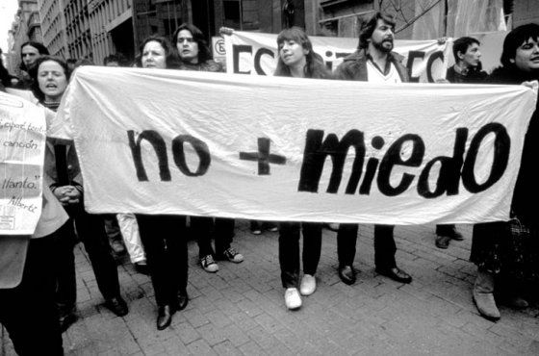
“Nothing was your own except the few cubic centimetres inside your skull”. Winston Smith, 1984 (George Orwell)

Slide 26
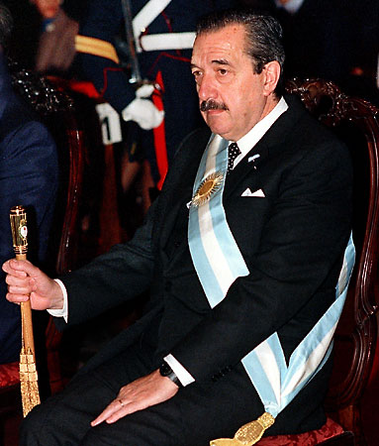
President Raúl Alfonsín (1983-1989)

Slide 27
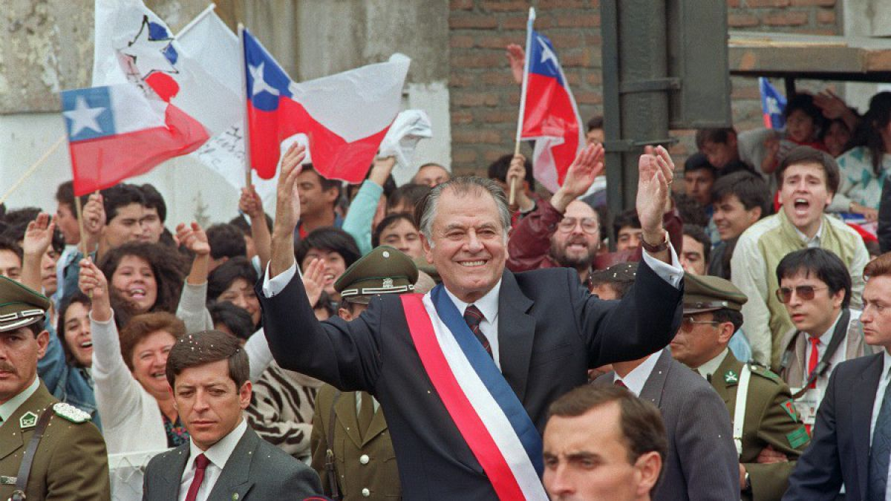
President Patricio Alwyn (1990-1994)

Slide 28
Transition from Authoritarian Rule
‘Distinctive moment in the political life and trajectory of a country’
Period of unknown duration and extraordinary uncertainty
Generally initiated from dynamics within the regime (hard and soft liners)
Changes precipitated often by civil society mobilisations and / or international pressure
Begins as restrictions may be loosened and some individual or group rights may be expanded at the whim of the regime – not irreversible
Karl: ‘Modes of transition are critical junctures in the long process of institutional accumulation; they are key moments in which the fragments and parts of the new regime are constructed, with each fragment becoming ‘an incentive for the addition of another’
Authoritarian regimes often face a series of simultaneous transitions:
WAR TO PEACE
AUTHORITARIANISM TO DEMOCRACY
WARTIME ECONOMY TO MARKET ECONOMY

Slide 29
Karl and Schmitter
Who are the main actors pushing for transition?
The elites or the masses?
Compromise or unilateral exercise of power?
4 Categories of Transition (not as simple as this)

Slide 30
Categories of Transition
Pacted transition: agreement between elite actors –Spain; SA
Reformist: results from mass mobilisation that is not met with systematic violence – dissolution of former Yugoslavia
Imposed: elites push regime change from above – Taiwan; Guatemala
Revolutionary: results from mass mobilisation despite resistance from elites - Madagascar
Collapsed: when regime collapses due to internal or external factors - Argentina

Slide 31
GILL:
Cannot understand transition without understanding civil society (175)
FIVE KEY CONTRIBUTIONS CAN BE COUNTED:
1. the potential threat posed by civil society forces: what factors cause a regime to liberalize when it is in trouble – an organized civil society may be key here in persuading or pressuring for liberalization instead of further tightening of restrictions;
2. the giving of democratic orientation to the regime: it is an exception that democratization occurs when regimes are in trouble – usually they simply replace on regime with a restructured one. People saw support for democracy instrumentally, and as a means fo getting them space within the political democracy. But when there is unity and a force from civil society that seeks broader changes on behalf of society as a whole, this will change the democratic direction of the regime.
3. the capacity of civil society to maintain the direction of change toward democracy and mobilization of supporters:: continuing pressure; public discourse; make it more difficult for an authoritarian backdown or reversal; public attention on elections;
4. provision of a negotiating partner for the regime:
5. civil society forces provide the basic social and political infrastructure which is necessary to sustain an emergent democratic system. Provides a stimulus to the process but also a constituent element of the construction of the new order – Lederach – peace architecture and infrastructure

Slide 32
The End of Transition?
General acceptance of outcomes of elections
‘founding elections’ (second successful election / handover of civilian power after end of regime)
Key moment: resurrection of civil society
Often transitions limp on, ’no war, no peace’

Slide 33
Liberalised authoritarian regimes (limited multiparty and electoral politics) - remarkably stable
Institutions / procedures provide a site for / allow negotiation of elite interests, facilitate the co-optation of potential reformers – they do not bring about meaningful change (Mexico? Guatemala?)
May lead to hybrid / schizophrenic regimes (Karl)
Coexistence of democratic and authoritarian procedures / norms / behaviour

Slide 34
The Aftermath of IAC and Authoritarianism
A&A: Indices, post-war/conflict countries are in a worse state THAN POST-AUTHORITARIAN STATES – war has had an enduring impact on their states, citizens’ perceptions, economies, political systems (is this correct?)
Freedom House Index and LAPOP – citizens in post-authoritarian states tend to show higher levels of support for democracy
Higher levels of violence in post-conflict states than post-authoritarian states
Higher investment in human development in post-authoritarian states
But both armed conflict and authoritarianism also impose lasting legacies on the perceptions of citizens

Slide 35
A&A: “citizens may still carry scars from the past and not be accustomed to engaging in dialogue to solve social and political conflicts and may have become habituated to living under authoritarian or pseudo-authoritarian governments”
Who are the spoiling actors (taxis in Cali)
Rebuild social fabric? Reconciliation / resignation?

Slide 36
The post-Authoritarian State
KEY ASPECT OF TRANSITION FROM AUTHORITARIAN RULE IS THE CONSTRUCTION OF A FUNCTIONAL STATE THAT GUARANTEES THE RULE OF LAW (LINK TO LIBERAL PEACE?)
In other words, an entity that provides institutional guarantees, controls monopoly of violence, guarantees rights, enjoys international recognition, institutionalises mechanisms to facilitate and regulate international relations (Levi / Weber) – THE STATE IS KEY
O’Donnell - LEGAL SYSTEM IS KEY to a functioning state – a constitutive element of the state that provides the regular, underlying texturing of the social order existing over a given territory – RULE OF LAW

Slide 37
Challenges for post-Authoritarian and post-Conflict States
States may face crisis of three dimensions:
Capacity to discharge their duties - weak or disintegrated capacity to respond to citizens’ needs and desires, provide basic services, assure welfare, or support normal economic activity
Effectiveness of their law (strength) - breakdown of law and order where state institutions lose their monopolies on legitimate use of force and are unable to protect their citizens
Representativeness of the state - in terms of whether state represents the public good in terms of equity and equality
Post-authoritarian states often situated along a spectrum that demonstrates these characteristics
The degree to which these characteristics are manifest may be disjunctive / change over time, moving forwards and backwards

Slide 38
O’DONNELL – Post-A STATES IN LLAA CHARACTERISED BY BROWN AREAS WHERE THE STATE PERHAPS NEITHER EXISTS NOR FUNCTIONS
GARRETON – AUTHORITARIAN ENCLAVES IN POST-CONFLICT AND POST-AUTHORITARIAN STATES, WHERE DEMOCRATIC VALUES AND AUTHORITARIAN VALUES COEXIST COMFORTABLY AND WHERE INSTITUTIONAL CAPACITY IS SYSTEMATICALLY WEAK and INSTITUTIONS CORRUPT
Distinction – institutions/policies/laws and perceptions (prejudices)
- Poll in Guatemala – private and public spaces
State matters in post-conflict reconstruction – but how much, and to detriment of other factors?
It’s likely that we can build all the institutions we like, but if we don’t engage with the affective aspect of post-conflict reconstruction – what counterinsurgents refer to as hearts and minds – then we are likely not to get anywhere

Slide 39
FINAL DILEMA - AN INEVITABLE TENSION BETWEEN ACHIEVING SHORTER TERM NEGATIVE GOAL OF ENDING DIRECT VIOLENCE AND PREVENTING A RELAPSE INTO WAR AND THE LONGER TERM POSITIVE GOAL OF BUILDING SUSTAINABLE PEACE
HOW CAN WE ACHIEVE THIS BALANCE??
WINNING THE PEACE MAKES GREATER DEMANDS THAN WINING THE WAR – NO WAR, NO PEACE

